Slide 1
Agile2014 Report
As a Speaker and a Reporter
of the latest Agile in the world
Aug/05/2014
Hiroyuki Ito
Development Process Optimization Department, Rakuten, Inc.
http://www.rakuten.co.jp/

Slide 2
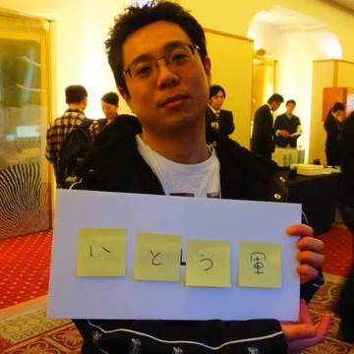
About me
Hiroyuki Ito
(The Hiro)
@hageyahhoo
Test-Driven
Development Group

Slide 3
What is Agile2014?

Slide 4
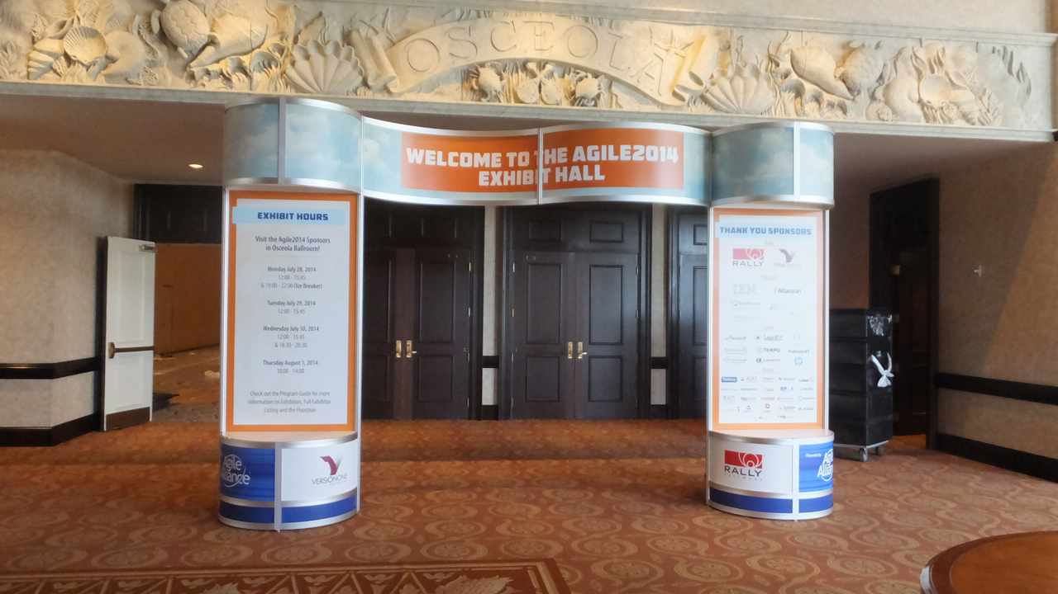



The world’s largest Agile Conference
WALL ATDD
WALL TDD
WALL CI/CD

Slide 5
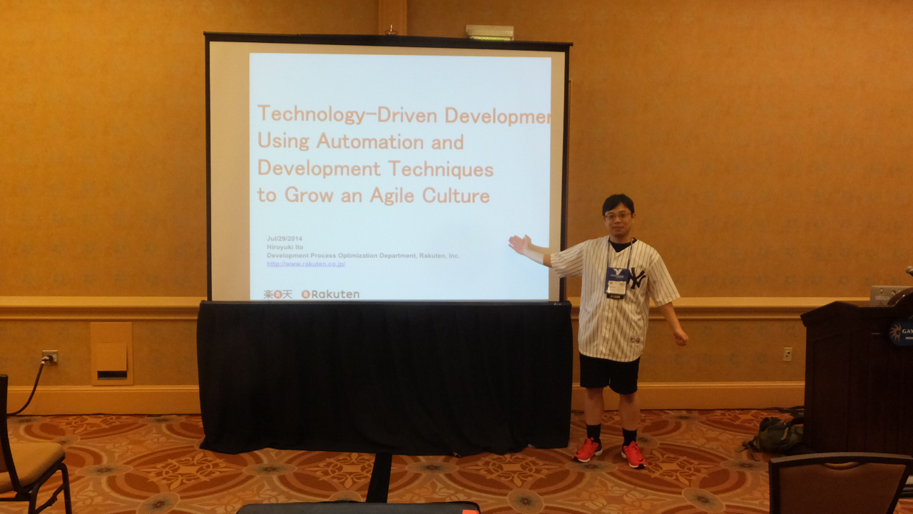
Attended as a session speaker!

Slide 6
Agenda
1. Basic Information of Agile2014
2. My Presentation
3. The Latest Trend of Agile
4. Conclusions

Slide 7
1. Basic Information of Agile2014
2. My Presentation
3. The Latest Trend of Agile
4. Conclusions

Slide 8
Basic information
Location | Orlando, Florida, U.S.
Duration | 4.5 days
Attendees | Approximately 2000 persons
Sessions | 272 sessions
Session Speakers | Over 280 persons

Slide 9
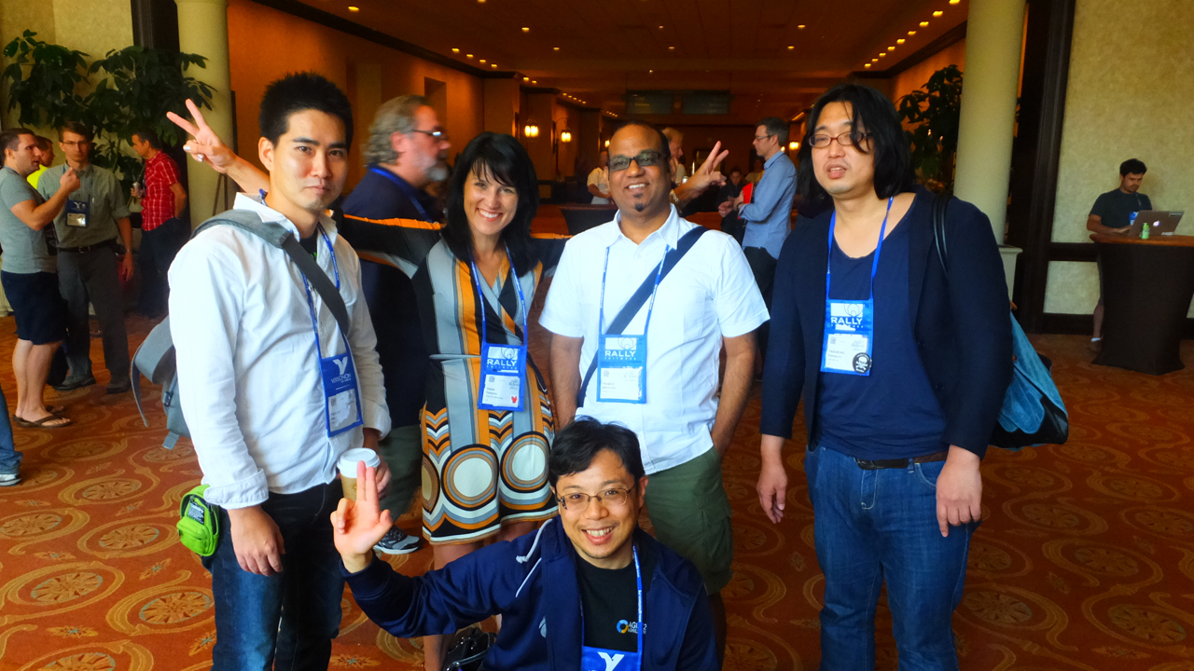
Rakuten all superstars!
Dana (R Marketing)
Pramod (PJM)
Abex (BDD)
Yasnob (TDD)
TheHiro (TDD)

Slide 10
Trend of sessions
Category | Sessions | Memo
Agile Bootcamp | 7
Coaching & Mentoring | 16
Testing & Quality Assurance | 13
Collaboration Culture & Teams | 23
Development Practices & Craftsmanship | 28
DevOps | 15
Enterprise Agile | 28
Project Program and Portfolio Management | 24
Experience Reports | 25 | TheHiro made a presentation here.
Keynote | 3
Leadership | 16
Learning | 15
Lightning Talks | 3
Open Jam | 4 | All day event held everyday.
Research | 9 | Including LT for researchers. 10 min/person.
Special Events | 9 | Including parties.
Stalwarts | 8
User Experience | 11
Working with Customers | 15
Total | 272
Related to
QA Section
Top-down
approaches
are increasing

Slide 11
Comparison of trends (with Yamaguchi-san @Yahoo)
Category | Sessions |  |  | Memo
 | 2012 | 2013 | 2014
Adoption & Transformation | 26 | 0 | 0 | Divided into “Enterprise Agile”, “Learning”, and so on.
Agile Bootcamp | 7 | 7 | 7
Coaching & Mentoring | 15 | 15 | 16
Distrubuted Agile | 5 | 0 | 0 | Held only in 2012.
Emerging Applications of Agile | 5 | 0 | 0 | Held only in 2012.
Croudsourced | 0 | 14 | 0 | Held only in 2013.
Lean Startup | 0 | 15 | 0 | Held only in 2013.
Testing & Quality Assurance | 12 | 11 | 13
Collaboration Culture & Teams | 18 | 15 | 23
Development Practices & Craftsmanship | 16 | 20 | 28
DevOps | 0 | 13 | 15
Enterprise Agile | 21 | 19 | 28
Project Program and Portfolio Management | 0 | 25 | 24
Experience Reports | 20 | 14 | 25
Keynote | 3 | 3 | 3
Leadership | 13 | 12 | 16
Learning | 0 | 17 | 15
Lightning Talks | 0 | 0 | 3 | 10 min/person.
Open Jam | 26 | 4 | 4 | Including “Coaches Clinic” in 2012.
Research | 8 | 9 | 9 | Including LT for researchers.
Special Events | 9 | 8 | 9 | Including parties.
Stalwarts | 9 | 7 | 8
User Experience | 12 | 14 | 11
Working with Customers | 17 | 17 | 15
Total | 242 | 259 | 272
Remaining
at the same level
Increasing

Slide 12
1. Basic Information of Agile2014
2. My Presentation
3. The Latest Trend of Agile
4. Conclusions

Slide 13
Information and documents
Session information
http://agile2014.sched.org/event/356d50c44035cafe4c27c33da03c2b80#
Paper published on Agile Alliance site
http://www.agilealliance.org/files/5014/0509/9284/ExperienceReport.2014.Ito.pdf
Presentation document published on Agile Alliance site
http://schd.ws/hosted_files/agile2014/65/1748_TechnologyDrivenDevelopment.pdf

Slide 14
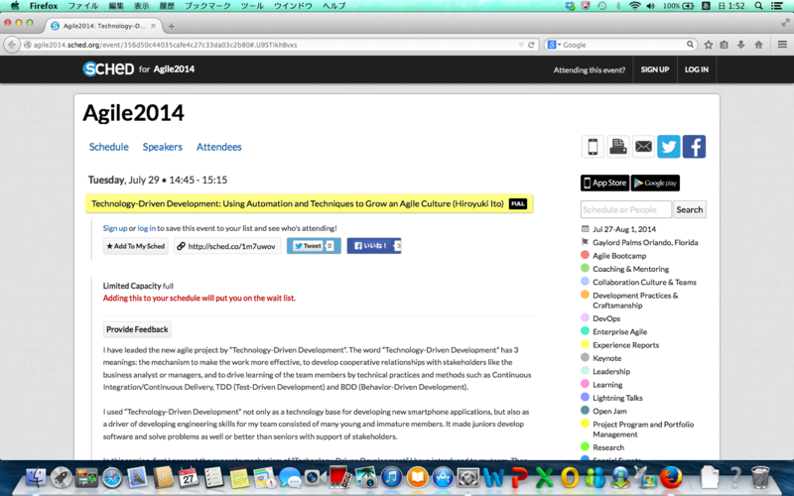
Before session

Slide 15
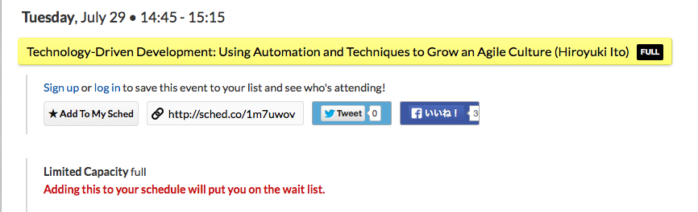
Before session (expanded)
Fully booked!?
(105 seats)

Slide 16
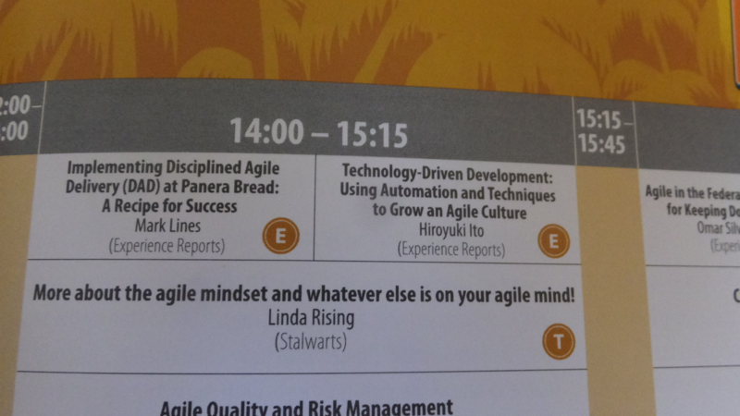
On session program

Slide 17
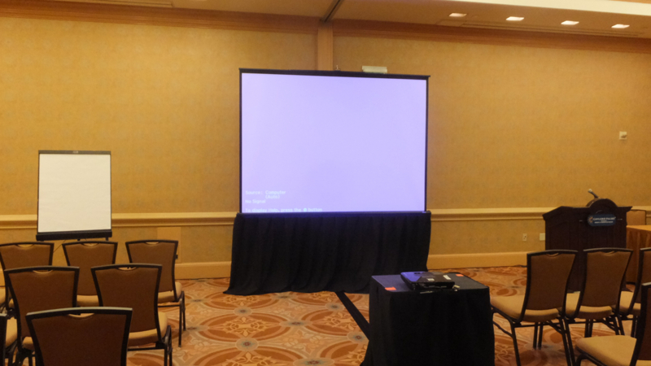
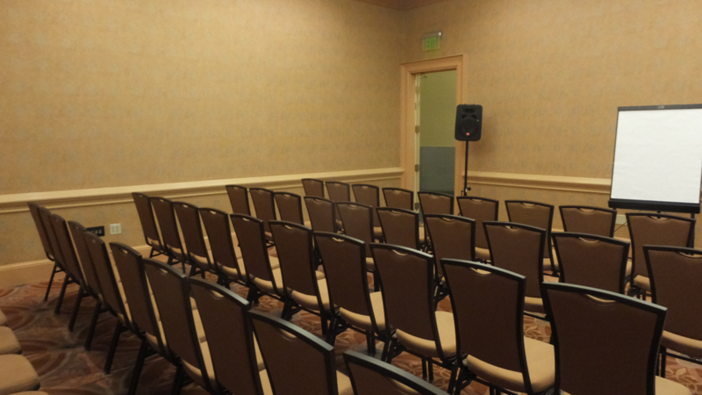
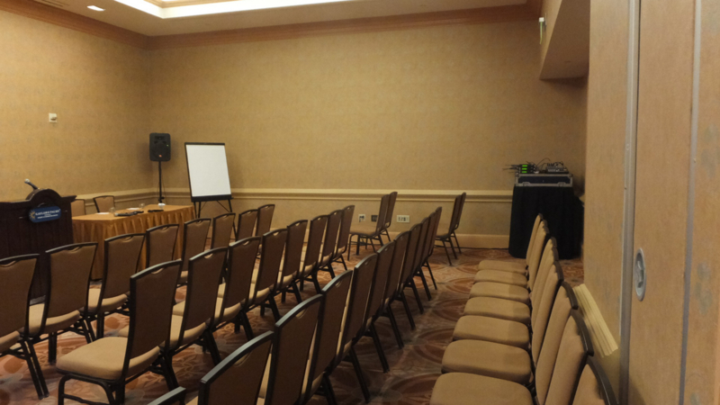
Venue

Slide 18
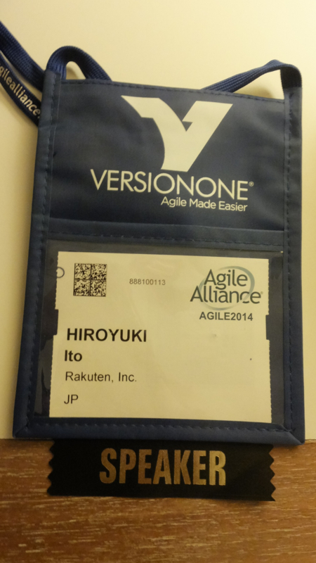
Key item as a speaker

Slide 19
Image of presentation

Slide 20
Result
About 60 persons attended.
Attendance Ratio = 57%
Average : about 50% (-> GOOD!)
Only 3 persons left during my presentation.
Remaining Ratio = 95%
Average : about 80% (-> GOOD!)
My shepherds often reacted positively during my presentation.
He is a real SAMURAI! (-> Maybe good ☺)

Slide 21
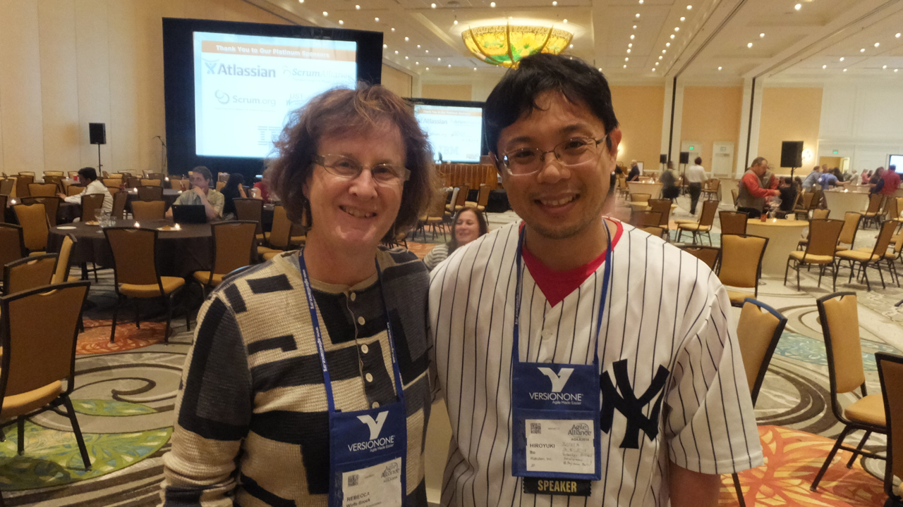
Rebecca Wirfs-Brock: Track chair

Slide 22
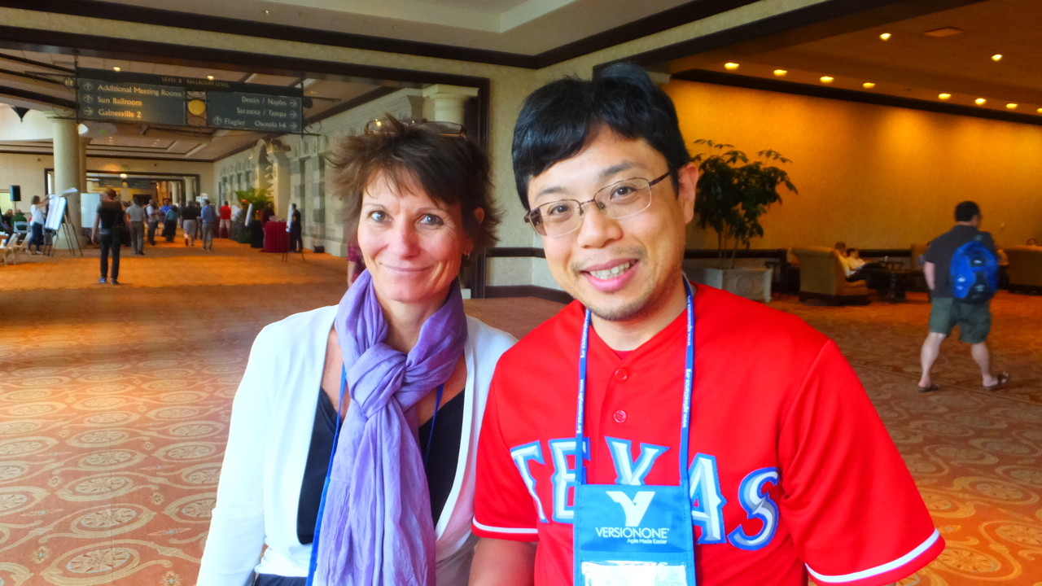
Jutta Eckstein: My shepherd

Slide 23
Impression
Englishnization is useful.
I had no trouble
making a presentation with English.
speaking in front of many English native speakers.
Practicing a presentation was very useful.
Feedback is very important before the real presentation.
Rakuten members gave me a lot of insightful feedbacks before the conference.
Writing a paper was very useful for
clarifying ideas got through your work.
acquiring how to think, evaluate, and explain objectively.
publishing ideas throughout the world easily and fast.

Slide 24
Next Action
Attend as a speaker again!
I have some themes
Advanced testing
Improve by metrics
Nurture younger members and colleagues
for consistent growth of our company.
Write and submit papers
Attend the next conference as a speaker

Slide 25
1. Basic Information of Agile2014
2. My Presentation
3. The Latest Trend of Agile
4. Conclusions

Slide 26
About 3 years ago
Value
Agile/Scrum/Lean

Slide 27
This year
Testing
BDD/ATDD/ET/MT
Metrics
CFD/Kanban/KPIs
Value
Enterprise Agile
Organizational Change/Psychology
Agile/Scrum/Lean

Slide 28
The latest trend of Agile
Agile, Scrum, and Lean are ordinary.
Most of practitioners are thinking about the better ways to utilize them more.
I found 3 big trends.
Organizational approach -> Enterprise Agile
Technical approach -> Testing
Combination of both -> Metrics

Slide 29
1. Enterprise Agile
Testing
BDD/ATDD/ET/MT
Metrics
CFD/Kanban/KPIs
Value
Enterprise Agile
Organizational Change/Psychology
Agile/Scrum/Lean

Slide 30
Ordinary Agile
Executives
Business
Analyst
Managers
UI/UX
Designers
Bottom-up
approach
Developers

Slide 31
Enterprise Agile
Top-down
approach
Executives
Business
Analyst
Managers
UI/UX
Designers
Decrease
silos
Developers

Slide 32
The trend of Enterprise Agile
Practitioner’s concern is changing
from improvement of development teams
to total optimization including executives and organization
Most of ideas are spiritual…
Not concrete
Most of speakers just say the importance of changing mindset
Expanding in the U.S.
On the other hand, the influence of SAFe
(Scaled Agile Framework) is increasing dramatically.
There were about 5 sessions about SAFe.
http://scaledagileframework.com/

Slide 33
Discussion about EA with other practitioners
It is ordinary to face with middle management layer and executive layer to adopt the bottom-up approach.
It is necessary to find and decrease wastes based on “command and control” organization and leadership.
Changing top’s mindset is useful for buy-in.
On the other hand,
we’d be better utilize technical foundation to avoid failures.

Slide 34
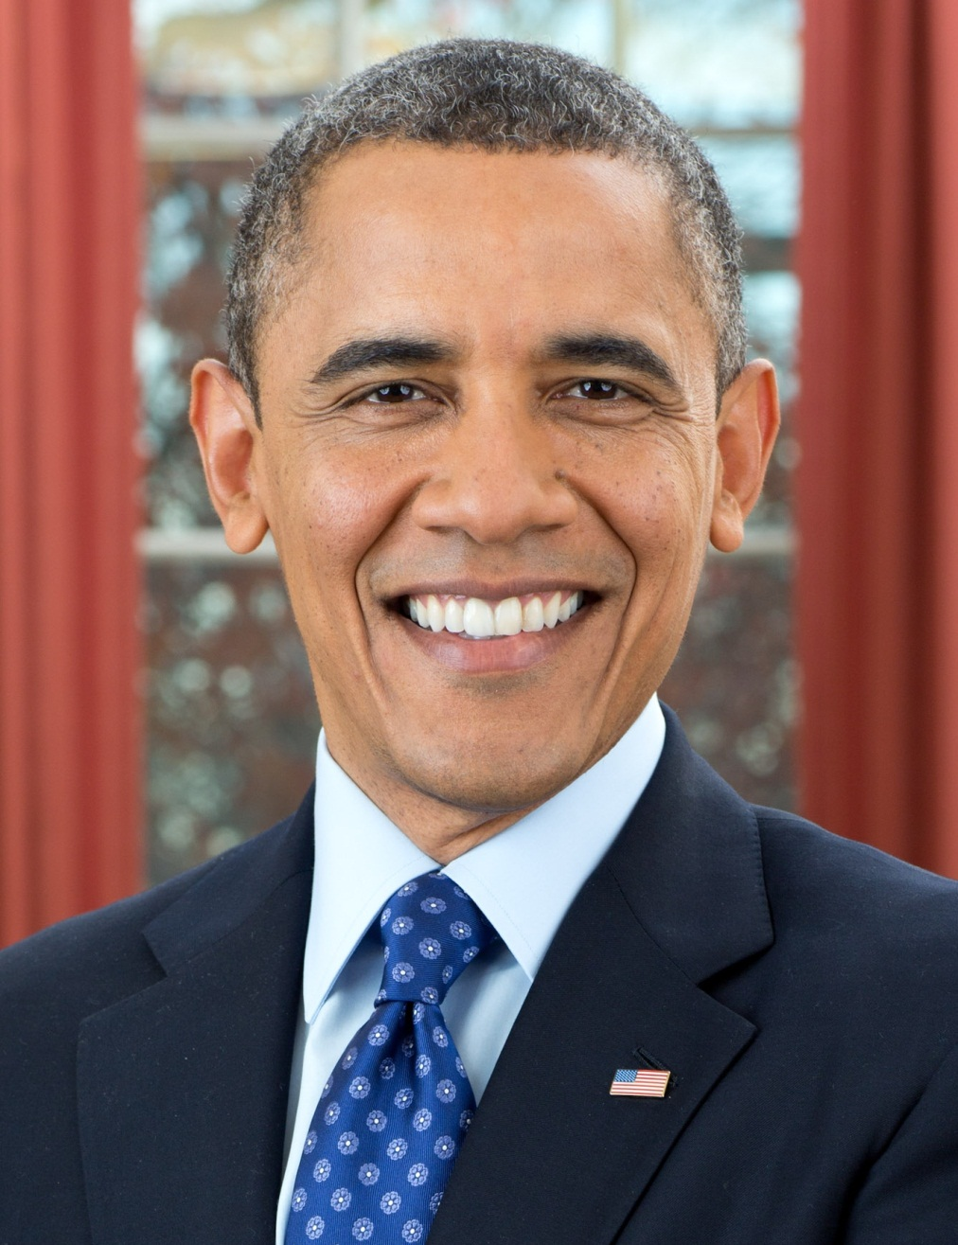
Changing mindset is very important, but…
YES, YOU CAN!

Slide 35
My opinion
Technical
foundation
is necessary!

Slide 36




e.g.) Use automation for collaboration
Check-in build (hourly)
My PC
Deliver to
all team members
automatically
Build applications
and run regression tests automatically
We demonstrate latest application
to the business analyst and managers
in every daily scrum

Slide 37
Working software for building shared understanding
Developers
Business
Analyst
Know about
the progress
Get fast feedback
UI/UX
Designers

Slide 38
2. Testing
Testing
BDD/ATDD/ET/MT
Metrics
CFD/Kanban/KPIs
Value
Enterprise Agile
Organizational Change/Psychology
Agile/Scrum/Lean

Slide 39
3 topics about testing
BDD/ATDD
Exploratory Testing
Mutation Testing

Slide 40
Pattern of Automation for BDD/ATDD
Specification by Example
Use “examples” to build shared understanding
Create high-level scenarios (by using domain words)
Create cross-functional team for reducing rework
Page Object Pattern
https://code.google.com/p/selenium/wiki/PageObjects
Default Data Pattern
http://www.cheezyworld.com/2010/11/21/ui-tests-default-dat/
Test Data Management Pattern
Prepare data for each test and rollback
Prepare data for all tests and rollback
Run all tests and commit all data

Slide 41
Current knowledge of Exploratory Testing
Session-based test management
http://www.satisfice.com/articles/sbtm.pdf
Test charters
http://www.qualitestgroup.com/howTo/How-to-write-an-Exploratory-Test-Charter
Heuristics
http://testobsessed.com/wp-content/uploads/2011/04/testheuristicscheatsheetv1.pdf
http://www.satisfice.com/tools/htsm.pdf

Slide 42
Mutation Testing (1)
<Example>
// Production code
int foo (int x, int y) {
int z = 0;
if ((x > 0) && (y > 0)) {
z = x;
}
return z;
}
// Test code
assertEquals(2, foo(2, 2))
assertEquals(0, foo(2, -1))
assertEquals(0, foo(-1, 2))

Slide 43
Mutation Testing (2)
<Add mutant>
// Production code
int foo (int x, int y) {
int z = 0;
if ((x > 0) && (y >= 0)) {
z = x;
}
return z;
}
// Test code
assertEquals(2, foo(2, 2))
assertEquals(0, foo(2, -1))
assertEquals(0, foo(-1, 2))

Slide 44
Mutation Testing (3)
<Kill mutant by changing unit test>
// Production code
int foo (int x, int y) {
int z = 0;
if ((x > 0) && (y >= 0)) {
z = x;
}
return z;
}
// Test code
assertEquals(2, foo(2, 2))
assertEquals(0, foo(2, 0))
assertEquals(0, foo(-1, 2))

Slide 45
Mutation Testing (4)
Objective of Mutation Testing is
adding mutant and find code smells.
Basically for improving unit testing.
Patterns of mutants
http://pitest.org/quickstart/mutators/
< to <= (adding “=“)
< to >= (reversing)
Reverse + and -
Make if statement invalid (e.g. if (true))
Change the value of constant
Change return value (e.g. null)
Erase method call

Slide 46
Mutation Testing (5)
Presentation document
http://schd.ws/hosted_files/agile2014/c1/1435_Mutation_Test_-_A_New_Way_to_Improve_Code_and_Test.pdf
Definition of Mutation Testing by Parasoft
http://www.parasoft.com/products/article.jsp?articleId=291
PIT (tool for Mutation Testing, for Java)
http://pitest.org/
Research of Mutation Testing
http://crestweb.cs.ucl.ac.uk/resources/mutation_testing_repository/

Slide 47
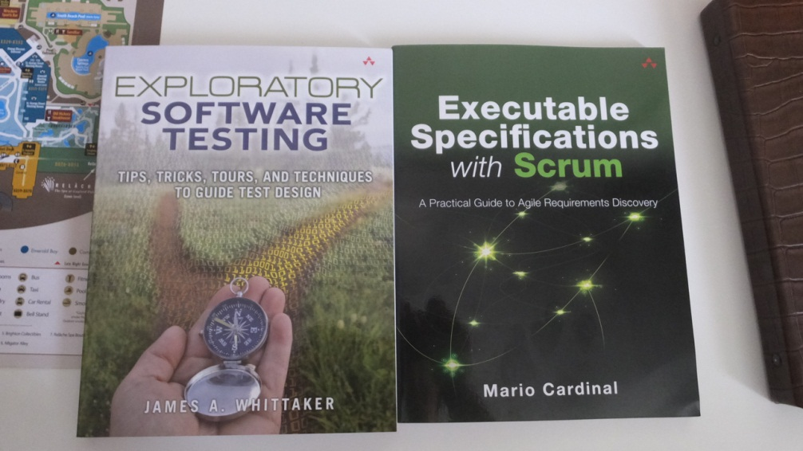
Next Action
Study more about BDD.
based on “Specification by Example”
Create Synergy among QA section members by
BDD, ATDD, Exploratory Testing, and Mutation Testing.
Create testable & clear specification for ease of testing
Enhance skills for test automation

Slide 48
3. Metrics
Testing
BDD/ATDD/ET/MT
Metrics
CFD/Kanban/KPIs
Value
Enterprise Agile
Organizational Change/Psychology
Agile/Scrum/Lean

Slide 49
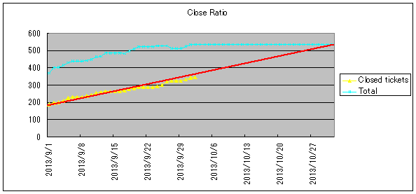
Example of metrics
Change requests : 3 times/week
Regression testing : 3 minutes/change
Install applications : 2 minutes/change

Slide 50

http://books.rakuten.co.jp/rk/91a2285c6f0b4fea867632bcd286bf1d/

Slide 51
Increasing concerns
Do the same thing in software product world.
For finding problems and knowing progress.
It is useful for clarifying the biggest point to improve.

Slide 52
“Useful Metrics in a Complex World” by Ken Power (1)
Ken’s paper
http://www.agilealliance.org/files/9814/0509/9343/ExperienceReport.2014.Power.pdf
Point of metrics
What perspective to measure?
What does work flow?
What impedes the flow of work?

Slide 53
“Useful Metrics in a Complex World” by Ken Power (2)
Cumulative flow
Useful for finding problems that impede velocity.
Know information by trend and hypothesize the following movement.
Throughput analysis
Useful for knowing the real progress.
Can distinguish the failure demand and value demand.
Cycle time
Useful for finding the difference among each status
of Kanban board.

Slide 54
“Useful Metrics in a Complex World” by Ken Power (3)
Point to use metrics
Review each metric continuously
Impression
The basic idea of metrics is to find problems and know progress.
Get information from the change of metrics.
Other person’s metrics are very insightful.
We’d be better decide who gather metrics.

Slide 55
Next Action
I decided to start the study session about metrics.
I have been preparing for the study session before attending Agile2014.
I will combine our experience of Gemba and the latest researches.

Slide 56
1. Basic Information of Agile2014
2. My Presentation
3. The Latest Trend of Agile
4. Conclusions

Slide 57
The essence of Agile
Agile is a continuous improvement action and process
that can adopt the whole things.
PDCA cycles
Less up-front rules
Create rules & processes by team members (mature)
Retrospectives
Based on numerical measurement (metrics)
Anything is ok to improve (automation, non-technical process)
For whole team/organization/company

Slide 58
The latest Agile
The essence of Agile is NOT changing.
Field is expanding.
Including organizational issues, testing, metrics, and so on.
You’d better clarify what you need and gather information
based on the the essence of Agile.
On the other hand, doing the essence by themselves is very difficult at present.
I will support it as an Agile Coach from now on.

Slide 59

http://agile2015.agilealliance.org/

Slide 60
Reference
Program of Agile2014
http://agile2014.agilealliance.org/program/
Papers and resources by Agile Alliance
http://www.agilealliance.org/resources/
My blog (Japanese)
http://d.hatena.ne.jp/hageyahhoo/

